Slide 1
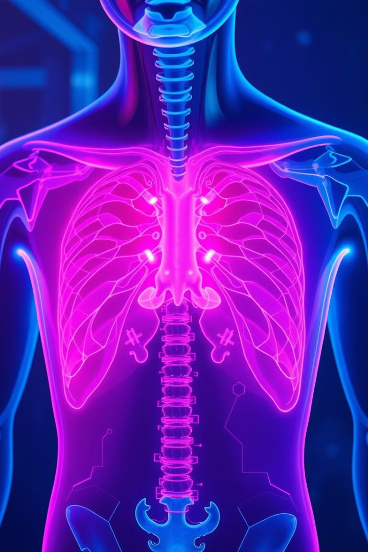
Pneumonia Detection Using CNN-based Feature Extraction
Automated system for accurate pneumonia diagnosis from chest X-rays.
Leverages deep learning to assist healthcare professionals.

Slide 2
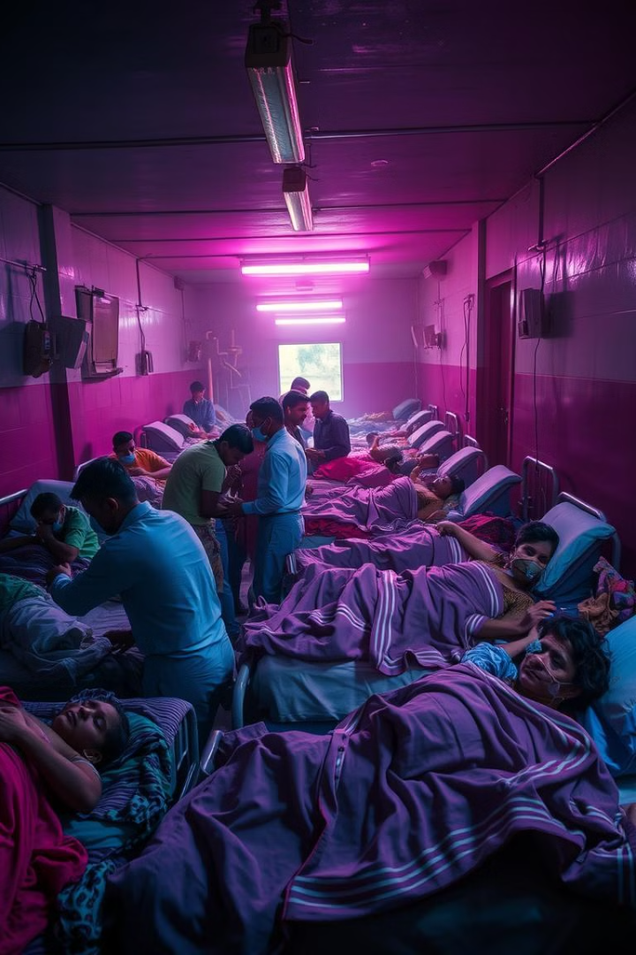
Pneumonia: A Global Health Challenge
1
Serious Lung Infection
Affects one or both lungs, caused by bacteria.
2
Significant Mortality
One in three deaths in India (WHO).
3
Diagnosis Challenges
Requires experienced radiologists to interpret chest X-rays.

Slide 3
Problem Statement
X-Ray Diagnosis Complexity
Misclassification Risk
Research Objective
Similar visual patterns with other conditions.
Overlapping features lead to delayed or incorrect treatment.
Use CNNs to classify X-rays into pneumonia-positive and normal cases.

Slide 4
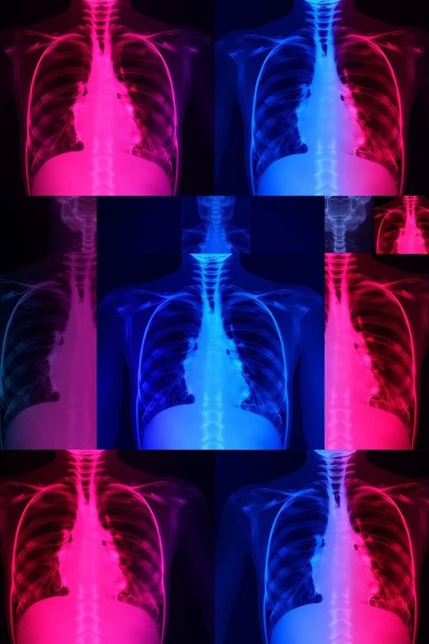
Dataset: ChestX-ray14
Total Images
112,120
Patients
30,085
Study Subset
2,862 (1,431 pneumonia, 1,431 normal)
Image Size
Downscaled to 224x224

Slide 5
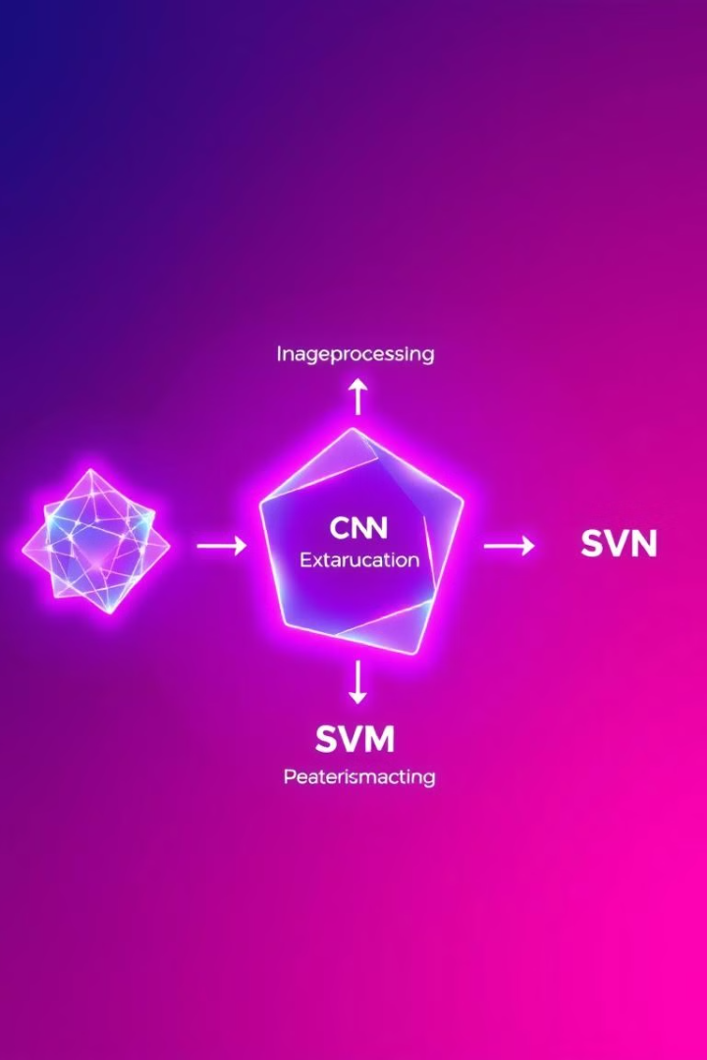
Methodology Overview
1
Preprocessing
Resize images to 224x224 pixels.
2
Feature Extraction
Use DenseNet-169 to extract image features.
3
Classification
Apply SVM to classify extracted features.

Slide 6





DenseNet-169 Architecture
Input Layer
Convolution and pooling for initial feature extraction.
Dense Blocks
Four blocks with dense connectivity between layers.
Transition Layers
Three layers for dimension reduction between blocks.
Output
50,176-dimensional feature vector for classification.

Slide 7
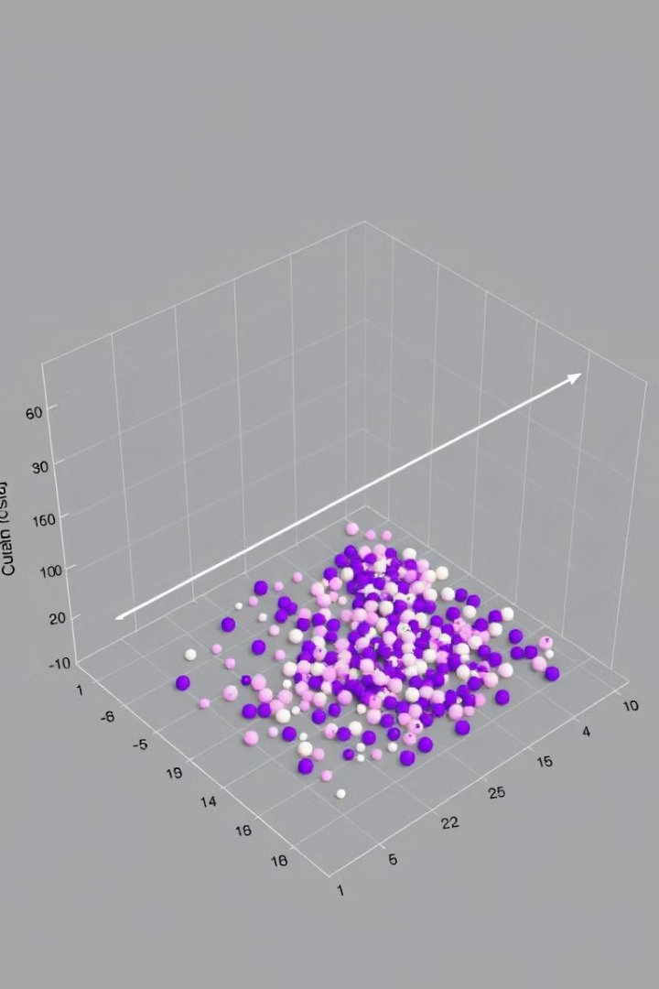




Classification Stage
SVM (RBF kernel)
Best performer, hyperparameter tuning improved performance.
Random Forest
Tested as alternative classifier.
K-nearest neighbors
Evaluated for comparison.
Naive Bayes
Included in classifier evaluation.

Slide 8
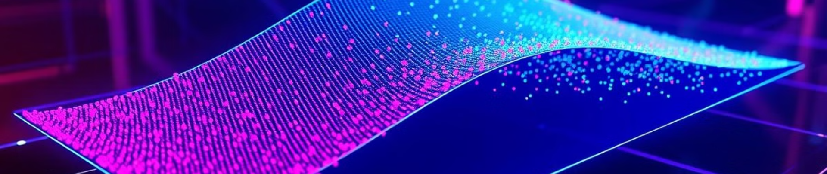
Classification with SVM
Classifier Choice
Hyperparameter Tuning
Final Configuration
SVM with RBF kernel outperformed other methods.
DenseNet-169 feature extraction + SVM classification.
Optimized C and γ for better performance.

Slide 9




Experimental Results
AUC Score
0.8002 achieved by DenseNet-169 + SVM.
Comparative Analysis
Outperformed ResNet-50 after hyperparameter tuning.
ROC Curve
Visual representation of model performance.

Slide 10
Model Strengths and Limitations
Strengths
Limitations
Future Improvements
High accuracy in distinguishing pneumonia from normal X-rays.
No patient history included.
Incorporate patient history and multi-view X-rays.
Only frontal X-rays used.
Useful for remote and resource-limited areas.
Optimize for faster computation.
High computational demands.

Slide 11
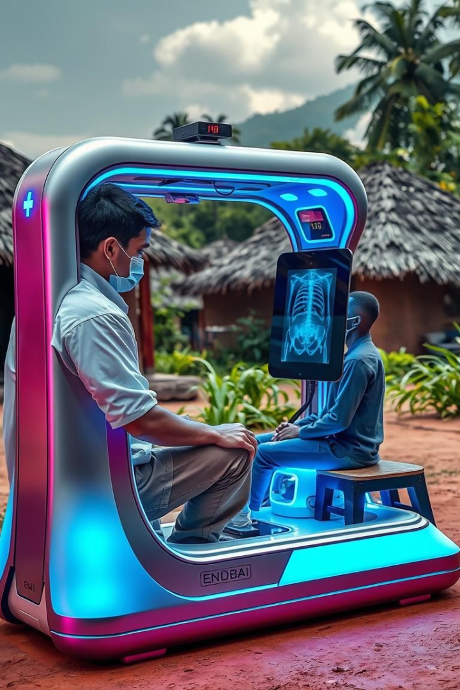
Conclusion and Future Directions
1
Effective Classification
DenseNet-169 + SVM model accurately detects pneumonia.
2
Early Diagnosis Support
Crucial for timely treatment in areas lacking radiologists.
3
Future Research
Enhance dataset diversity and integrate clinical data.
4
Lightweight Architectures
Explore to reduce computational requirements.

